Slide 1
LAMENTATIONS

Slide 2
LAMENTATIONS
“And it came to pass, after Israel was taken captive, and Jerusalem made desolate, that Jeremiah sat weeping, and
lamented with this lamentation over Jerusalem, and said.…”
LXX Superscription

Slide 3
LAMENTATIONS
Structure: 5 chapters = 5 poems
1, 2, 4, 5 = 22 verses each
3 = 66 verses
All are acrostics except 5
1-4 = "limping meter" ~ funeral dirges

Slide 4
LAMENTATIONS
Chapter 1: Provocation against God
Chapter 2: Punishment from God
Chapter 3: Prophet and God
Chapter 4: People of God
Chapter 5: Prayer to God

Slide 5
LAMENTATIONS
Read on Tisha B'Av ~ 7th of Av (Jul-Aug)

Slide 6
LAMENTATIONS
Lamentations “Wordle”

Slide 7
LAMENTATIONS
Unclean thing ~ KJV, 
menstrous woman
monstrous woman

Slide 8
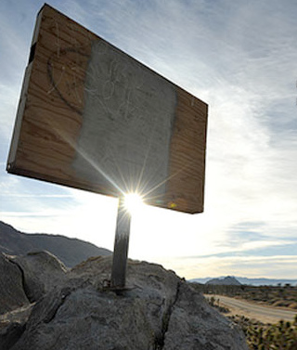
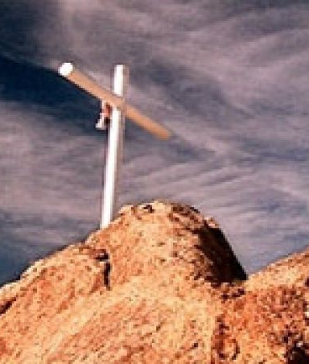
LAMENTATIONS
www.donttearmedown.org

Slide 9
LAMENTATIONS
There once was a man named Jeremiah
Who, to us, has become a pariah
He's such a buffoon
As he prophesies doom
Sitting atop Mt. Moriah

Slide 10
LAMENTATIONS
Ash heap ~ KJV, dunghills 

Slide 11
LAMENTATIONS
²⁹ In those days they shall say no more: "The fathers have eaten sour grapes, And the children’s teeth are set on edge."
³⁰ But every one shall die for his own iniquity; every man who eats the sour grapes, his teeth shall be set on edge.
Jeremiah 30.29-30

Slide 12
LAMENTATIONS
Renew ~ or, repair

Slide 13
LAMENTATIONS
All that the Father gives Me will come to Me, and the one who comes to Me I will by no means cast out.
John 6.37

